Slide 1

Employee Sentiment & Company Performance Analysis
Santhoshkumar | Aspiring Data Analyst
Snigdha kola | Aspiring Data Analyst
Nazneen begum | Aspiring Data Analyst

Slide 2

Problem & Motivation :
Lack of Clear Insights
Job seekers struggle with limited company insights.
Misleading Ratings
Simple ratings often don't tell the full story.
Need for Data-Driven Analysis
A deeper, data-driven approach to employee sentiment is essential.

Slide 3




Project Objective :
Analyze Employee Sentiment
Dive deep into employee feelings and perceptions.
Identify Trends
Uncover sector-wise and city-wise patterns.
Understand Patterns
Examine relationships between hiring and engagement.

Slide 4

Key Business Questions :
1
2
Sector Ratings
Reviews & Hiring
Which sectors receive higher employee ratings?
Do employee reviews impact hiring decisions?
3
Dominant Cities
Which cities offer the most job opportunities?

Slide 5
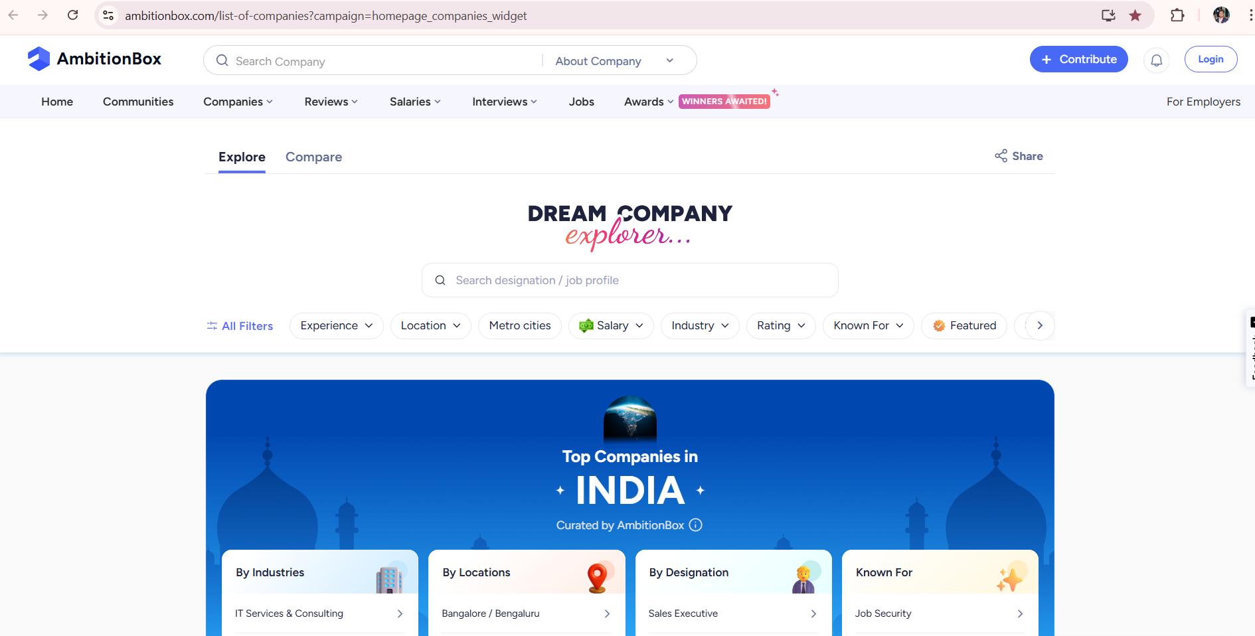
Data Source :
Platform – AmbitionBox
Method - Web-scraped company data
Scope - Covers multiple sectors and cities
Website URL:
https://www.ambitionbox.com/list-of-companies?campaign=homepage_companies_widget

Slide 6
Key Columns :
Company_Name: Identifier for each company.
Primary_City: Main operational city.
Ratings: Employee satisfaction scores.
Company_Sector: Industry sector of the company.
Reviews_Count: Number of employee reviews.
Jobs_Count: Number of open job positions.
Salary_Count: Number of reported salaries.

Slide 7



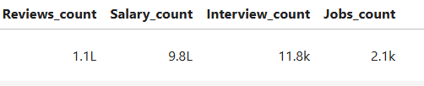
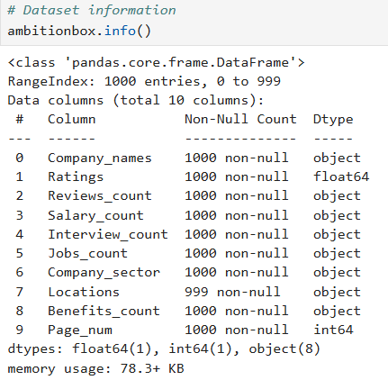
Data Quality Issues :
Non-Numeric Values
Missing Values
Inconsistent Formats
Presence of 'k', 'L', and '--' in numerical fields.
Gaps in city and sector information.
Variations in data representation.

Slide 8
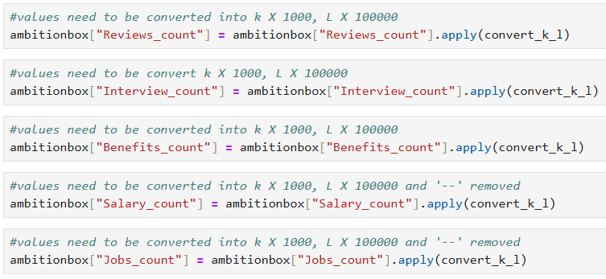



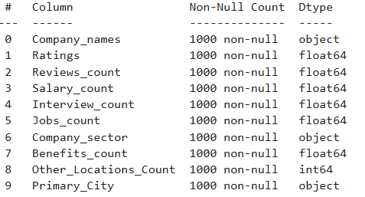

Data Cleaning Steps :
Convert Values
Transformed text values (e.g., 'k', 'L') to numeric.
Handle Missing Data
Logically addressed and imputed missing city and sector values.
Standardize Names
Ensured consistent naming for cities and sectors.

Slide 9


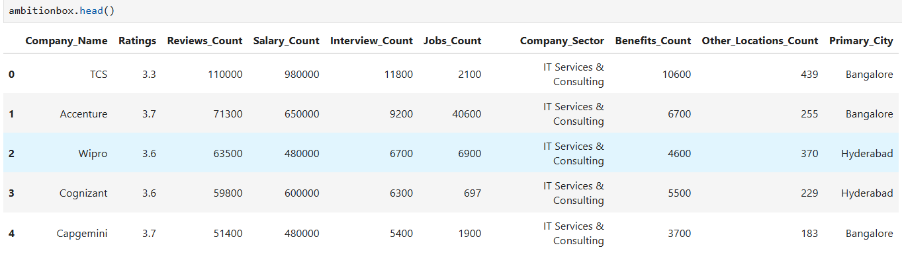
Clean Data Ready :
100%
0%
Ready
Correct Data Types
Critical Missing Values
All data fields are now in their appropriate formats.
No significant missing data remaining.
Ready for Analysis
Dataset is prepared for EDA and visualization.

Slide 10
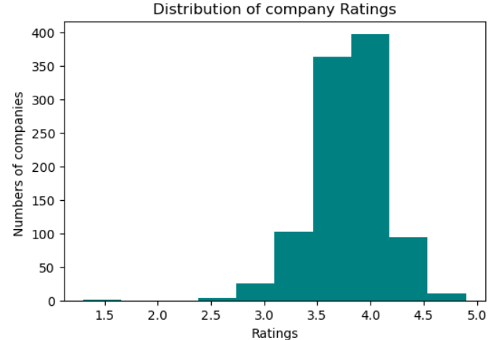
Univariate Analysis graphs:
Histogram Plot:
Observation (from the histogram):
Most companies have ratings clustered between mid-range values rather than at the extremes.
The distribution is slightly right-skewed, with fewer companies having very high ratings.
Very low and very high ratings are less frequent, indicating ratings are concentrated around the average range.
Tekwissen, Royal Migration Solutions,etc..having Highest ratings(4.9).
Stellar Migration having the lowest ratings(1.3).

Slide 11
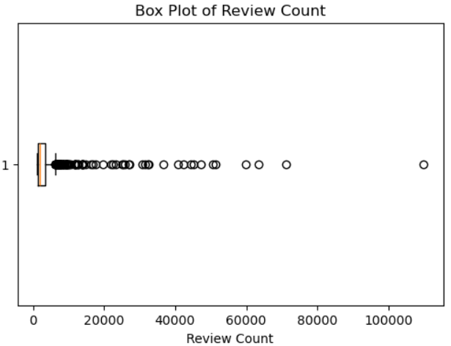
Box Plot of Review Count:
Observation (from the box plot):
The distribution of review counts is highly right-skewed.
Most companies have a low to moderate number of reviews, clustered near the lower end.
Several extreme outliers are present, representing companies with a very large number of reviews.
TCS having Highest review count(11000).
Nippon Life India Asset Management and 26 other companies are having reviews less than 1000.

Slide 12
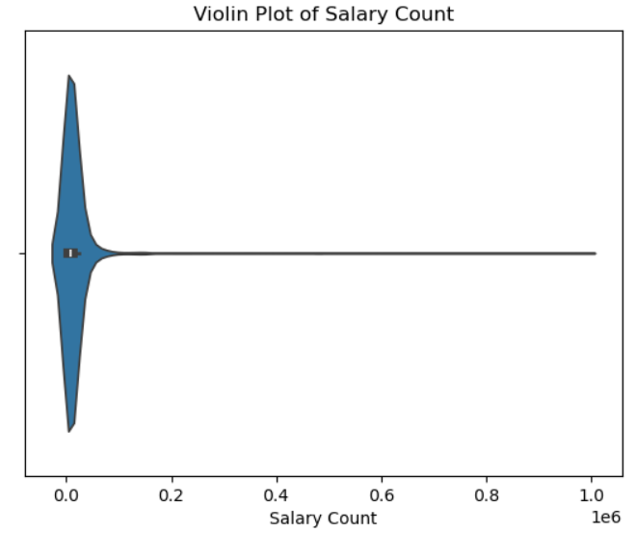
Observation (Violin Plot of Salary Count):
The distribution of salary count is highly right-skewed.
Most companies have a low number of salary entries, concentrated near the lower end.
A few companies have very high salary counts, creating a long right tail.
This indicates that salary data is dominated by a small number of large companies, while most have limited salary records.
25% of companies like Stellar Migration etc.. have low number of salary entries.
75% of companies like Imperial Auto Industries etc..have very high salary counts.
Violin Plot of Salary Count:

Slide 13
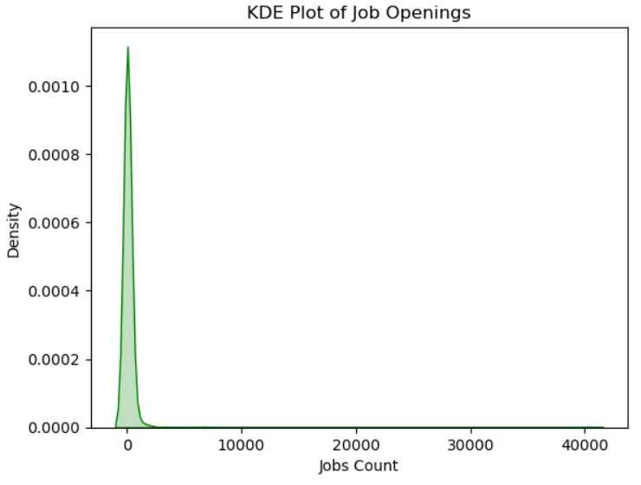
Observation (KDE Plot of Job Openings):
The distribution of job openings is right-skewed, with most companies having a small number of open positions.
A few companies show very high job counts, creating a long tail on the right.
The density peaks at lower values, indicating that the majority of firms have limited hiring activity.
Overall, job opportunities are concentrated among a small number of large companies.
Companies like Accenture, Bajaj Finance,Wipro ect..having highest range of job openings, indicating aggressive hiring and large workforce demand compared to others.
KDE Plot of Job Openings:

Slide 14
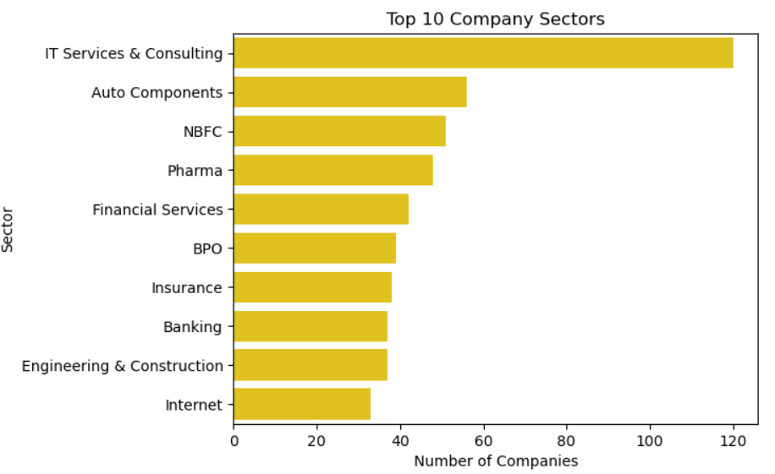
Observation :
The top 10 sectors dominate the dataset, showing that most companies belong to a few major industries.
Sectors like IT Services, Consulting, and Technology-related fields are the most common.
This indicates a high concentration of companies in tech and service sectors compared to others.
Companies like Tekwissen, Kogta Financial India Limited etc.. companies belong to the Top 10 most common sectors in the dataset
Count plot on Top 10 Company Sectors:

Slide 15
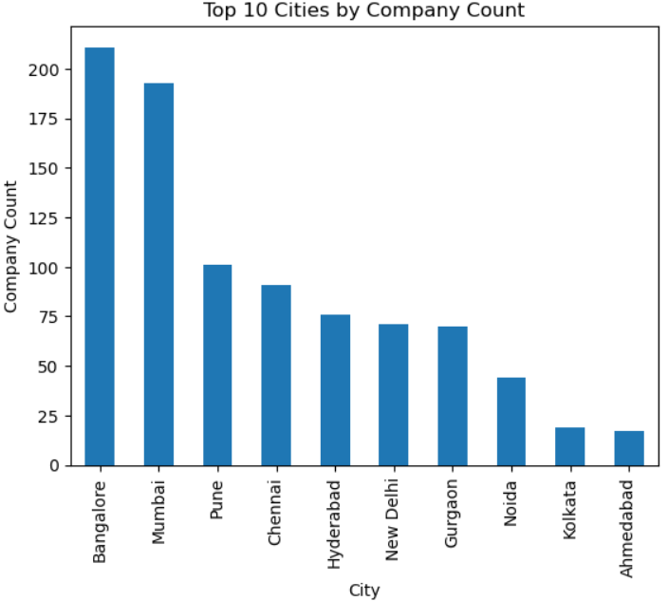
Bar plot for Top 10 Cities by Company Count:
Observation:
A few major cities have the highest concentration of companies.
Metro cities dominate, indicating better job and business opportunities in urban areas.
This shows that companies are geographically concentrated rather than evenly distributed across locations.
Companies likeMarpu Foundation, Indian Army,etc..These companies are located in the top metro cities, showing strong geographical concentration.

Slide 16
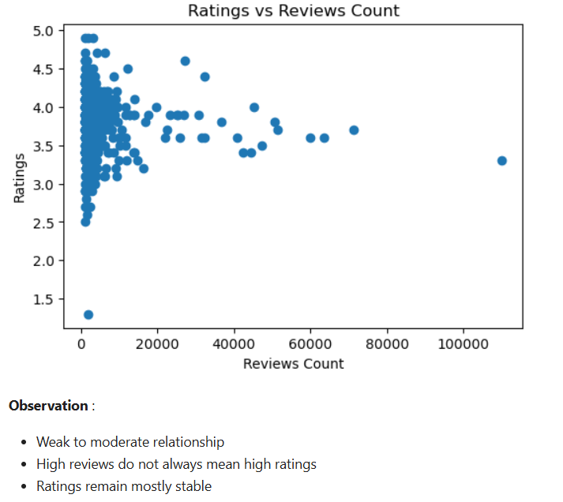
2.Bivariate Analysis:
Understanding Employee Satisfaction
Scatter Plot:
Observation:
There is no strong correlation between number of reviews and ratings.
Most companies cluster around average ratings (3–4).
Ratings with more reviews are more reliable than those with few reviews.
Companies like TCS, Accenture etc.. Having more reviews are more reliable than those with few reviews.

Slide 17
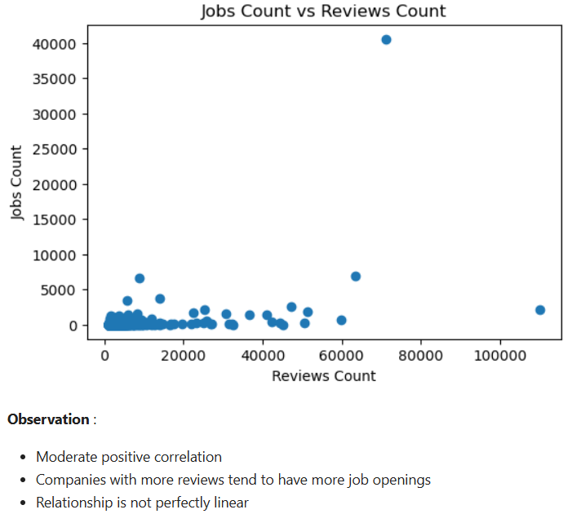
Reviews vs. Jobs Insight: The Engagement-Hiring Link
Our bivariate analysis reveals a compelling connection between the volume of company reviews and the number of job postings, indicating a dynamic interplay
between employee engagement and hiring activity.
Moderate Positive Correlation
There is a discernible moderate positive correlation between the number of company reviews and the volume of job openings.
Engagement & Hiring Connection
This suggests that companies with higher levels of employee engagement, often reflected in more reviews, tend to be more actively involved in hiring.
This correlation implies that a robust and active employee community might be a strong indicator of a growing company with frequent hiring needs.

Slide 18
Reviews, Jobs & Salary Insight:
Analyzing the distributions of reviews, job postings, and salaries reveals a highly imbalanced ecosystem, where a few entities hold significant influence.
Highly Right-Skewed Distributions
The data for reviews, job postings, and salaries show a pronounced right-skew, meaning a large number of companies have low values, while a few have exceptionally high values.
Few Companies Dominate
This skew indicates that a select group of companies receive the vast majority of reviews, post the most jobs, and likely offer the highest salaries, driving market perception and talent attraction.

Slide 19
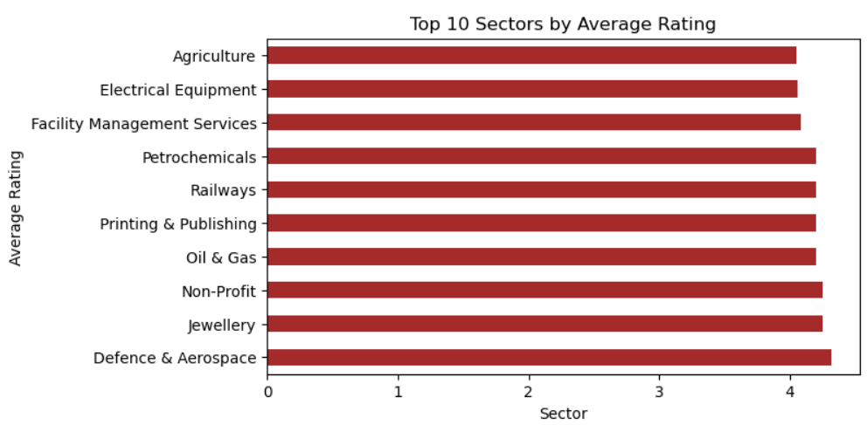
Horizontal Bar plot:
Observation:
Clear sector differences: Some sectors consistently have higher average ratings, indicating better employee satisfaction.
Top sectors lead in work culture: The highest-rated sectors likely offer better work environment and benefits.
Variation across sectors: Not all sectors perform equally employee experience depends strongly on industry type.

Slide 20
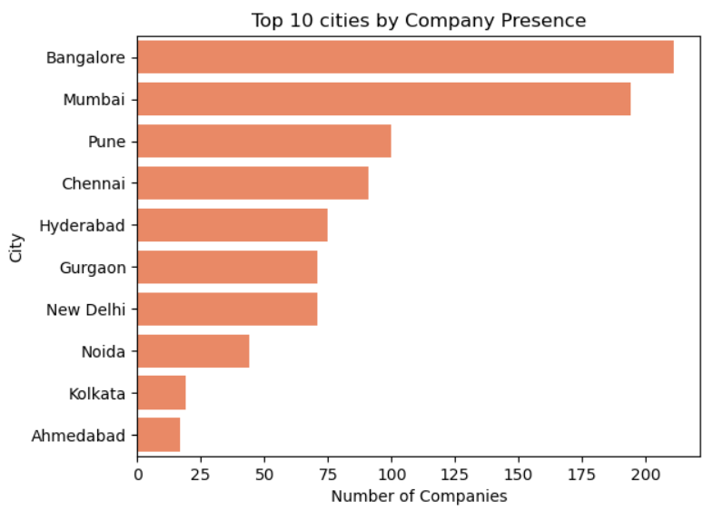
Count plot:
Top 10 cities by Company Presence
Observation:
Metro cities dominate: Cities like Bangalore, Mumbai, Delhi, Hyderabad, and Chennai have the highest company presence.
Tech hubs lead: Most top cities are IT and business hubs, attracting more companies.
Urban concentration: Company presence is heavily concentrated in major metropolitan areas, with fewer companies in smaller cities.

Slide 21
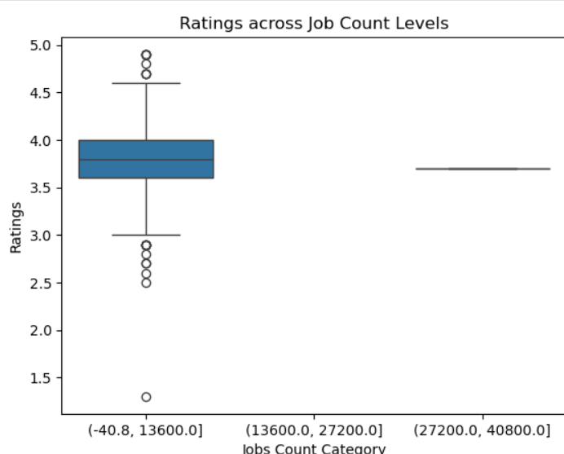
Box plot:
Ratings across Job Count Level:
Observation:
Most companies like Accenture etc ,have similar ratings (around 3–4).
Companies with more jobs have slightly higher ratings.
Companies with fewer jobs show more ups and downs in ratings.

Slide 22
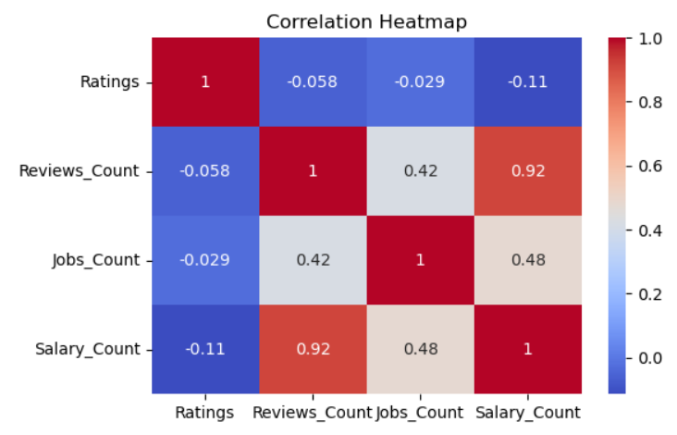
3.Multivariate Analysis:
Correlation Heat map:
Observation:
Reviews and Salary counts move together – more reviews means more salary data.
Reviews and Jobs are related – companies with more reviews usually have more jobs.
Ratings are weakly related – ratings don’t change much with reviews, jobs, or salaries.

Slide 23
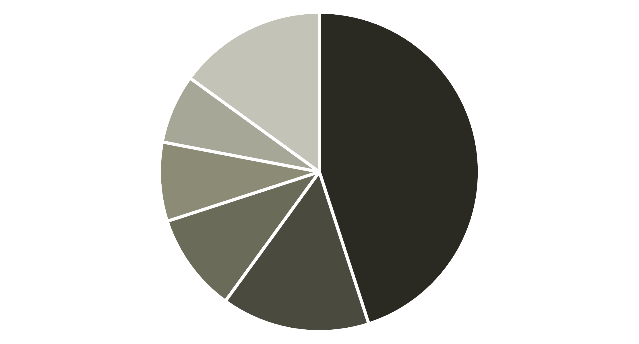
Sector Distribution: The Dominance of IT Services
Examining the distribution of companies across various sectors reveals a significant concentration in IT Services, highlighting a potential
imbalance in the dataset and the market.
IT Services
Consulting
Finance
Healthcare
Manufacturing
Others
The IT Services sector significantly outweighs others in terms of company representation, suggesting a need to
consider this bias in further analysis.

Slide 24
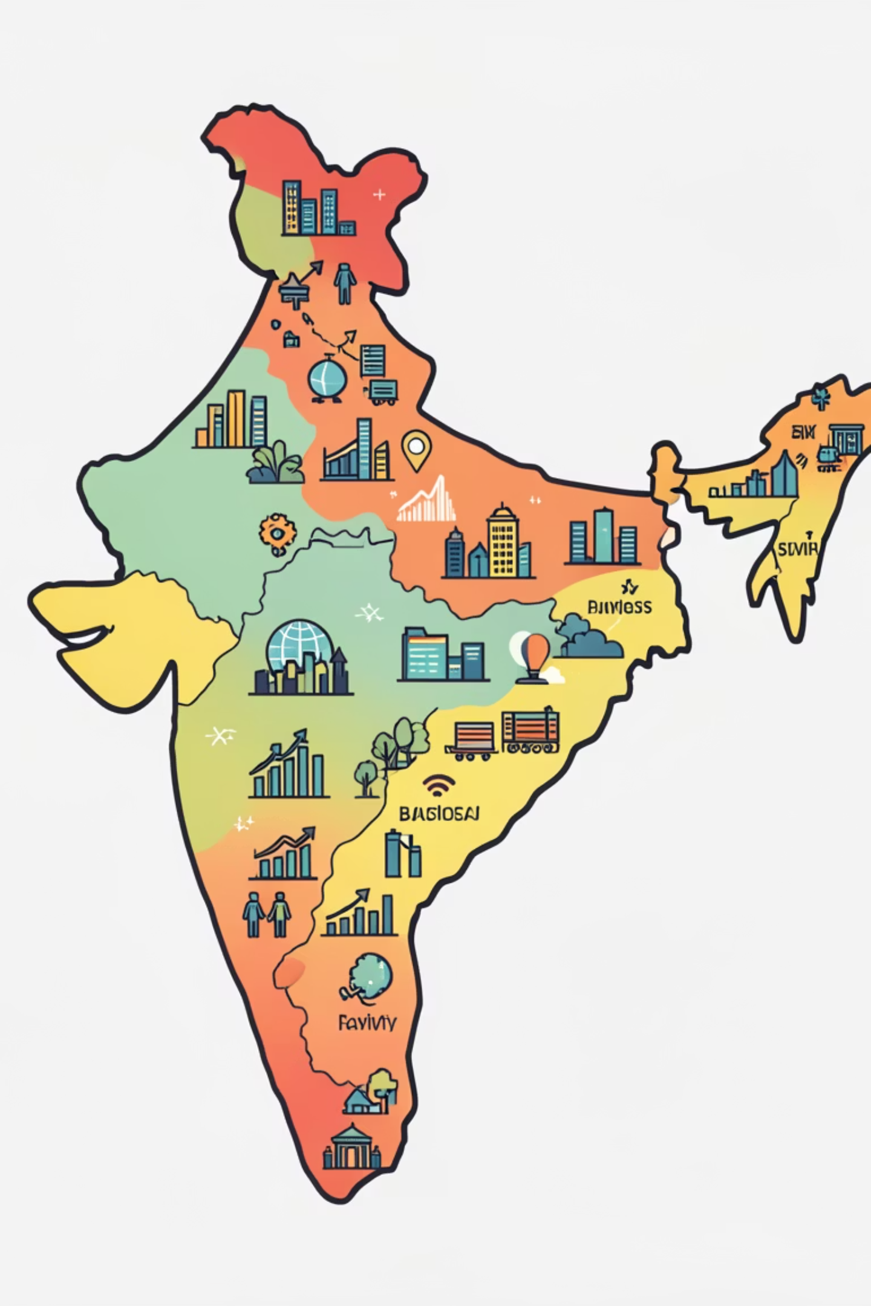



City Distribution: The Urban Concentration
Our dataset clearly illustrates a strong concentration of companies in major metropolitan areas, particularly key tech and business hubs.
Bangalore
Often referred to as the "Silicon Valley of India," Bangalore stands out as a primary hub for tech companies.
Mumbai
India's financial capital, Mumbai, also shows a strong presence, especially for finance and diverse business services.
Pune
Emerging as another significant IT and manufacturing center, Pune rounds out the top three cities in our dataset.
The dominance of metro cities in the dataset is evident, with Bangalore, Mumbai, and Pune leading the concentration of companies.

Slide 25

Higher Feedback Companies :
Hire In Global and Tekwissen have the highest employee ratings (4.9), showing strong employee satisfaction.
TCS and Accenture have the highest Reviews, Salary records, Interview experiences, and Benefits, indicating a very large workforce and active employee participation.
Accenture and Bajaj Finance have the highest Jobs_Count feedback, reflecting strong hiring activity.
Jio and HDFC Bank have the highest location spread, indicating wide geographical operations across India.

Slide 26
Low Feedback Companies :
Stellar Migration and Mu Sigma have the lowest ratings, indicating very poor employee satisfaction.
Hire In Global and Bajaj Capital Insurance Broking Limited have the lowest Reviews_Count (1000), reflecting limited employee participation or smaller organizational reach.
Several companies show extremely low Salary_Count, with values near 0–57, suggesting missing data or low salary engagement.
Stellar Migration and Royal Migration Solutions have the lowest salary feedback counts.
Interview activity is minimal in low-performing companies, with some having only 1–2 interview records, indicating weak
hiring presence.
Royal Migration Solutions and Stellar Migration have the lowest interview feedback counts.
Many firms report 0 job openings, meaning no active recruitment compared to top companies (Hire In Global, HSBC Electronic Data Processing).

Slide 27
Low Feedback Companies :
Benefits offered are very limited, with most low companies having only 1 benefit entry, showing weaker employee welfare (Royal Migration Solutions, Bluestock™).
Tekwissen and Stellar Migration have low Other_Locations_Count, meaning limited geographical expansion.

Slide 28
Overall Trends and Patterns :
Employee ratings are generally stable and not strongly influenced by company size.
Metro cities dominate company presence and hiring activity.
Reviews and job openings show a moderate positive correlation.
Specialized sectors tend to have higher employee satisfaction.
Company culture varies more by sector than by hiring volume.

Slide 29



Performance Level Summary :
13 companies fall under the High-level category across all feedback metrics, indicating strong overall performance and employee engagement.
10 companies fall under the Medium-level category across all feedback metrics, representing average and stable performance.
15 companies fall under the Low-level category across all feedback metrics, reflecting weaker employee sentiment and limited engagement.

Slide 30

Final Insight :
This analysis helps job seekers identify high-satisfaction sectors and cities, and enables companies to benchmark employee sentiment against peers.

Slide 31

THANK YOU

